Slide 1
INDIVIDUAL HOMEWORK
Exercise 10.2

Slide 2
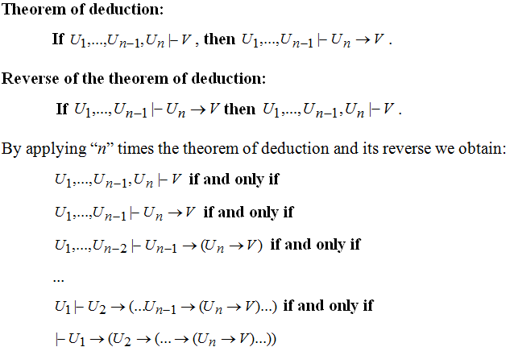
THEOREM OF DEDUCTION AND ITS REVERSE

Slide 3
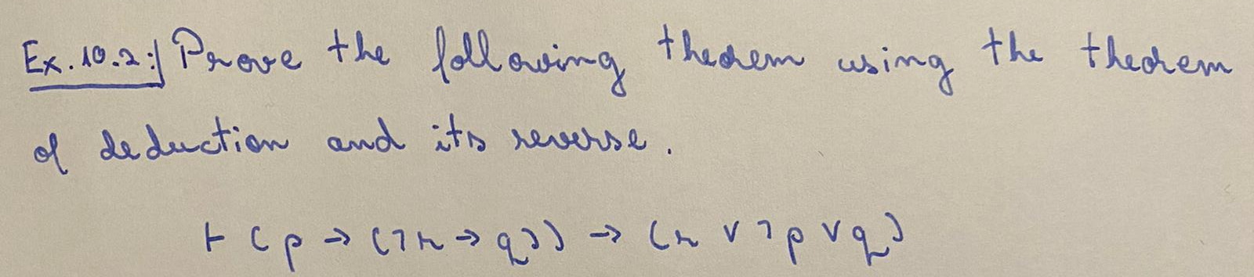

Slide 4
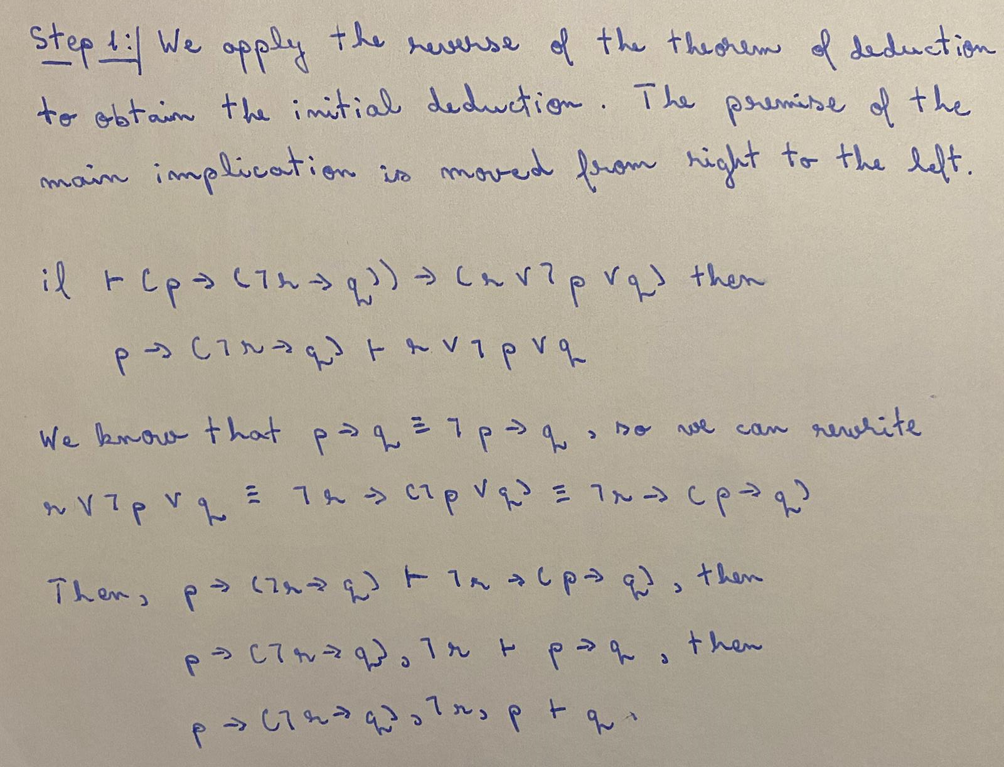

Slide 5
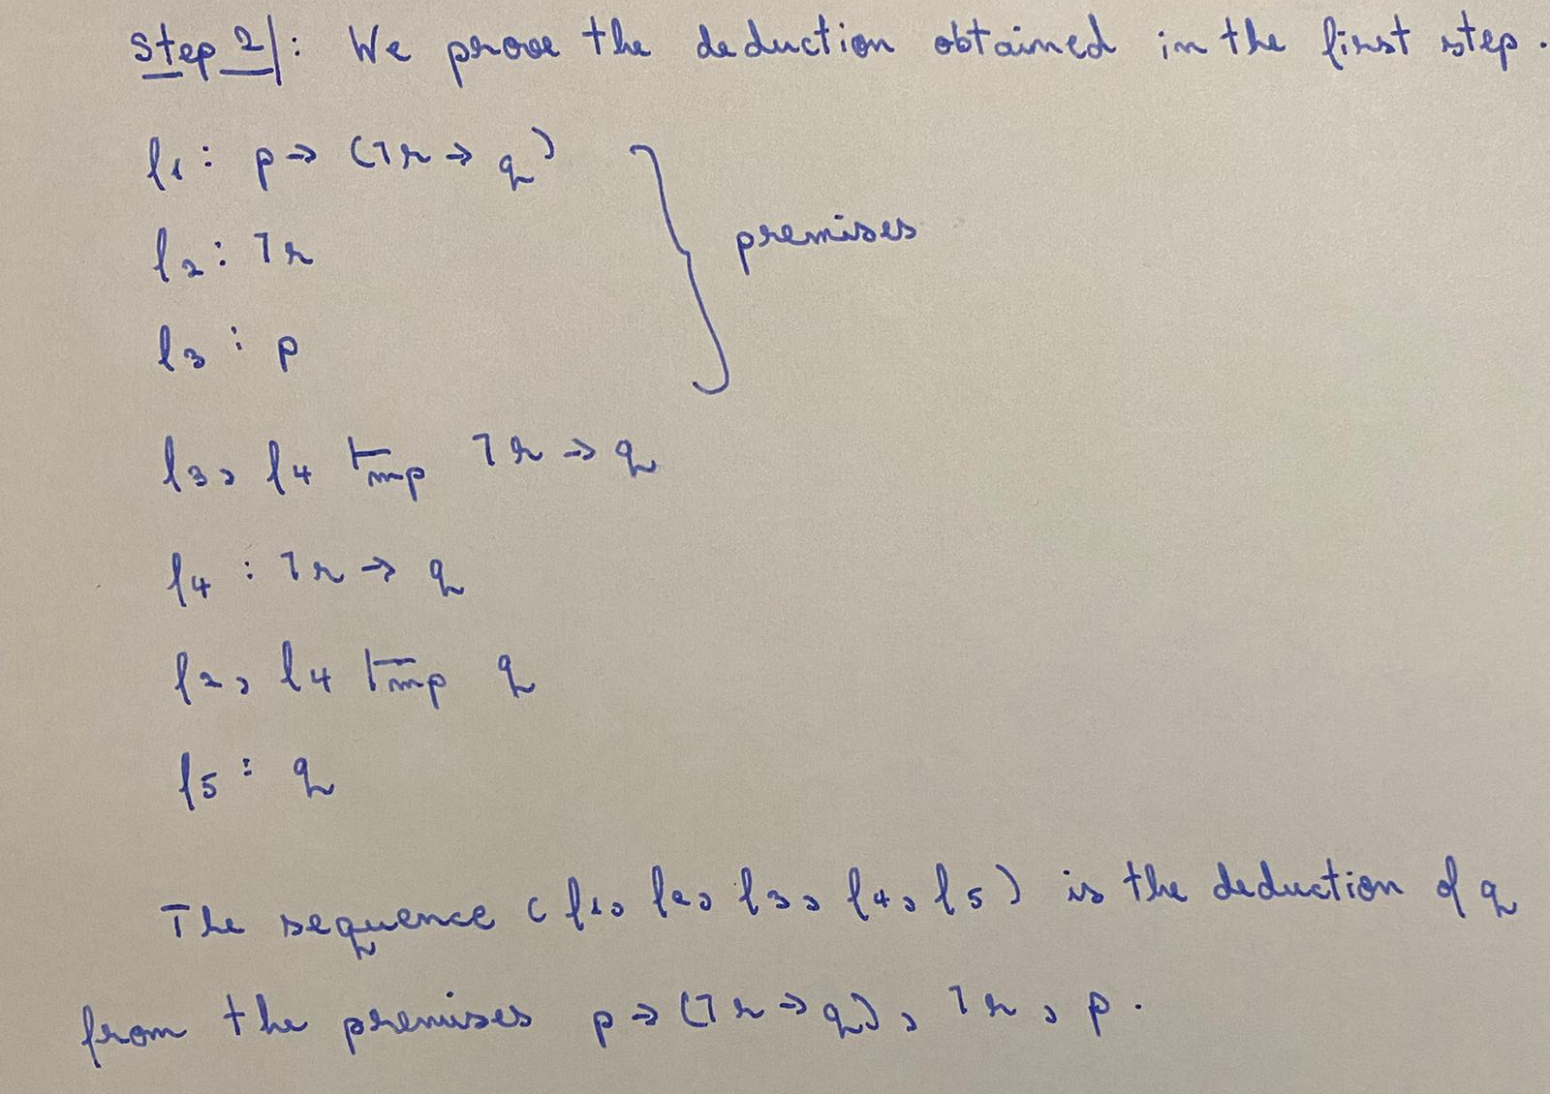

Slide 6
